Slide 1
E-invoicing Implementation
InvoiceQ for E-invocing & Integration

Slide 2
What is E-invoicing?

Slide 3
E-invoicing Around The World
The Future of Invoicing: E-Invoicing on The Rise
-E-invoicing is becoming the new global standard for business transactions.
-Many Middle Eastern countries are mandating E-invoices.
-Regulations may vary from country to country, but the goal remains the same.

Slide 4
550
Facts and Numbers
billion
No. Digital invoices
55
billion
2019
2035

Slide 5
Who’s InvoiceQ?

Slide 6
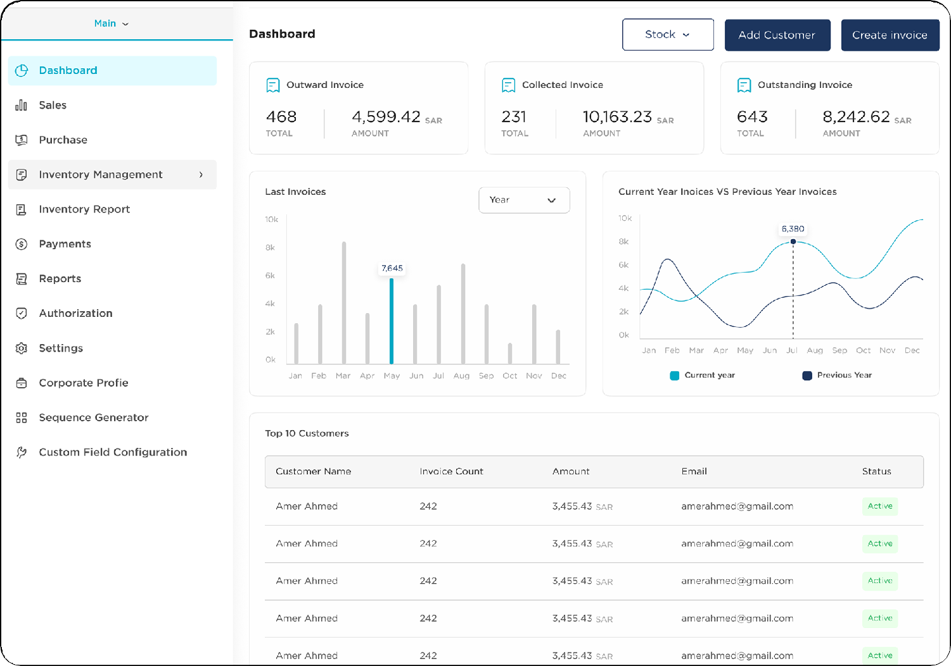
Solutions We offer
Interactive dashboard and reports for sales, purchases invoices
Manage internal authorizations
API Integration with any system
Send outward invoices
Receive inward invoices
Collect invoices electronically through payment gateways

Slide 7
InvoiceQ
in Saudi Arabia

Slide 8
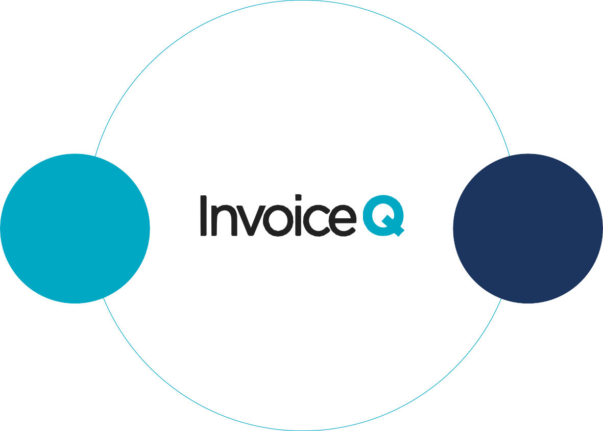
ERP/POS
system
SFTP
Tax Authority
Integration
Payment gateways

Slide 9
InvoiceQ in Jordan

Slide 10
ERP/POS
system
SFTP
Tax Authority
Integration
Payment gateways

Slide 11
InvoiceQ in Numbers
+10M
Number of E-invoices issued annually
+4B $
Total annual value of issued invoices

Slide 12
Technical Considerations

Slide 13
PEPPOL Framework is implemented at InvoiceQ to ensure compliance with the latest updates, how does this help keep the InvoiceQ system on track?

Slide 14
Data Privacy & archiving are managed with up-to-date protocols to protect users’ personal data, how do we handle this?

Slide 15
What are the most important technical considerations to look out for when choosing a service provider?

Slide 16
ERP integration varies among companies, how do we deal with each scenario without compromising our clients' needs?

Slide 17
Benefits of InvoiceQ System

Slide 18
Faster Payments Collection
Cost Saving
Regulatory Compliance
Improved Accuracy
Standardized Data Format
Real-time Updates
Automated Workflows
Enhanced Traceability

Slide 19
More Info
Jordan website: jo.invoiceq.com KSA website: invoiceq.com

